Slide 1
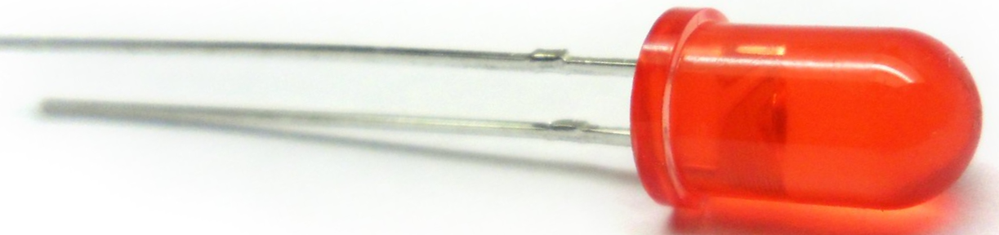
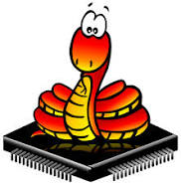

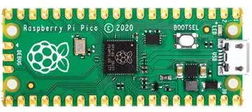
MicroPython
MicroPython
https://micropython.org
Wouter van Ooijen
wouter@voti.nl

Slide 2

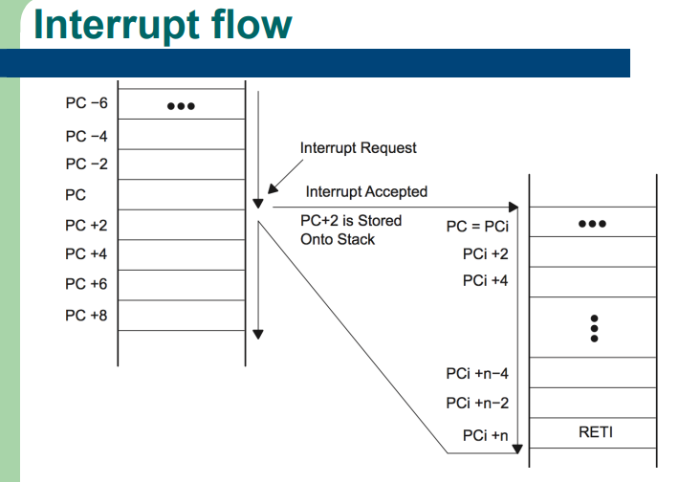
Questions are welcome

Slide 3
Me
TU Delft Informatica 1988
ICT Automatisering
VAX11 industrial datacommunication
@ Fokker Space / Dutch Space: Era Robotic ARM
@ Hollandse Signaal / Thales: SmartNet ATM datacommunications system
VOTI webshop, self-employed (NLR), projects
Hogeschool Utrecht: lecturer Technische Informatica
C, C++, assembler, Python, SE, electronics, Java
Cboost
C++ and embedded specialist
Wouter van Ooijen
wouter@voti.nl
Programmer by profession, electronics tinkerer by passion

Slide 4
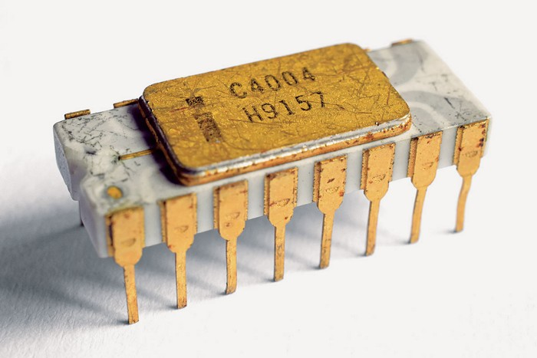
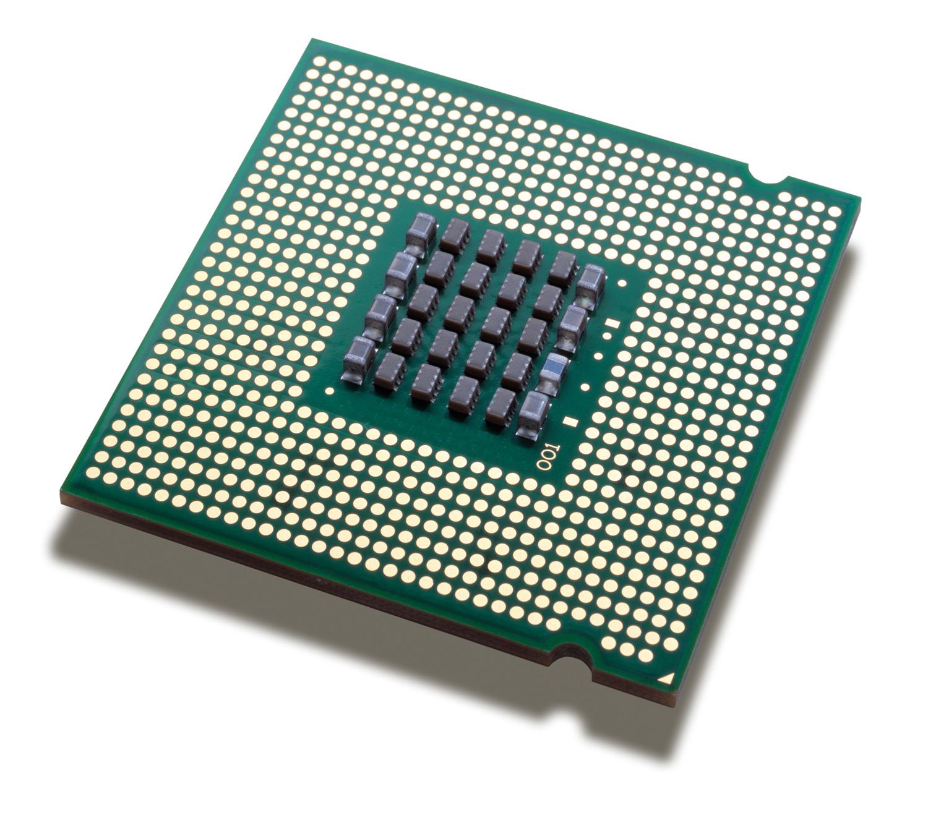
Micro-processor
1971
0.1 MIPS
4 bits
A micro-processor is:
CPU only
What is in your desktop, laptop, server, mobile
$$$
Optimized for processing power
Uses external ROM, RAM, peripherals, ...
Needs LOTS of power (and often cooling)
faster
2023
300 GIPS
64 bits

Slide 5
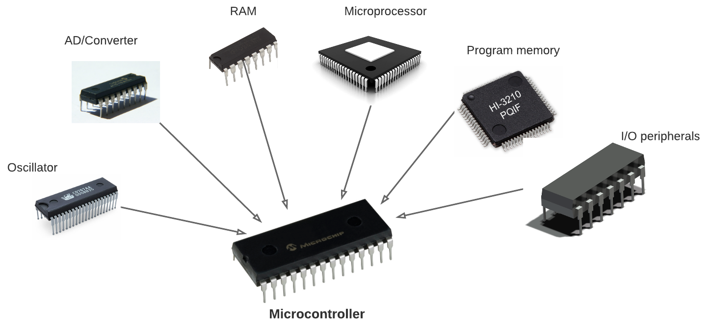
Micro-controller
1971
just the CPU
A micro-controller is
A single* chip with CPU, RAM, FLASH, I/O, …
Cheap, small, low-power
Used for embedded, real-time
(Much) less resources than a desktop
What you find in almost everything that is not a computer
Include more
(OK, a bit faster too)
2023
CPU, MMU
ROM, RAM
GPIO, A/D, D/A
I2C, SPI, I2S
….

Slide 6
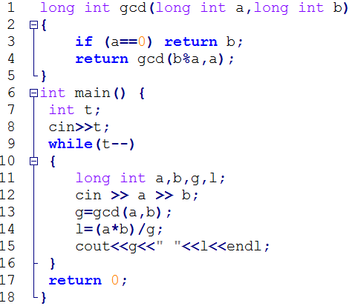



Compiler
Translates
Runs
Source code
Compiler
Runs
CPU
interaction
Application

Slide 7
Interpreter
Interprets
Runs
Source code
Interpreter
CPU
interaction

Slide 8
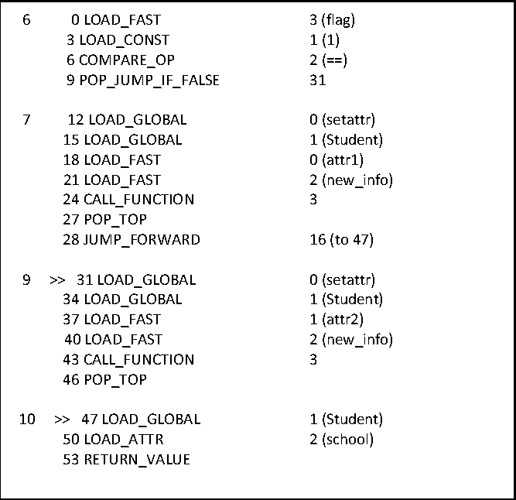
Compiler / Interpreter
Compiler
Translates
Runs
Source code
Runs
CPU
Interprets
interaction
Intermediate code
Interpreter / Virtual Machine

Slide 9

(C)Python
Source code
CPU

Slide 10

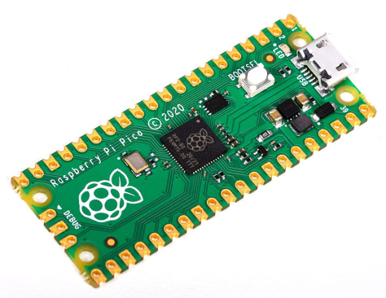
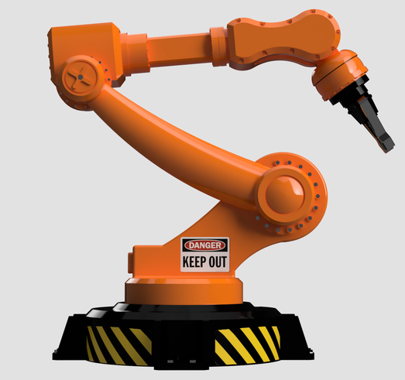
MicroPython
Thonny
Desktop CPU
On the PC
REPL
On the MC
MicroController
MicroPython

Slide 11
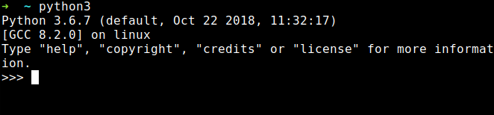
(Micro)Python REPL
Read-Evaluate-Print Loop:
Connects to your PC via serial-over-USB*
Read your input
Evaluate (run) it
Print the result
Repeat this forever
Acts as a primitive Operating System command interpreter
Provides a simple file system
Can interrupt a running program

Slide 12
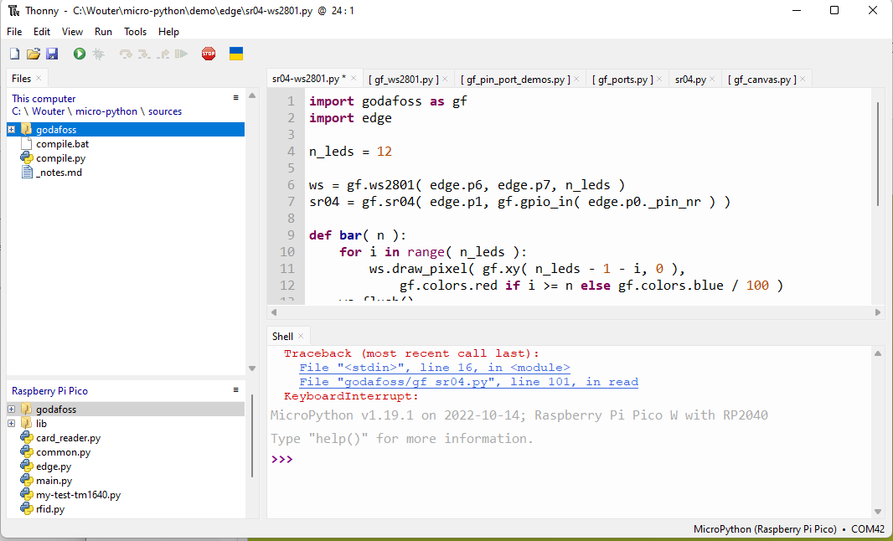
Thonny
Simple Python edit-run IDE
Can be configured to run remotely via REPL over (USB-) serial
Has very simple but useable file system views, with upload / download *
Can directly install MicroPython on some target chips
Editor is a bit primitive (I prefer Notepad++ for serious editing work)

Slide 13
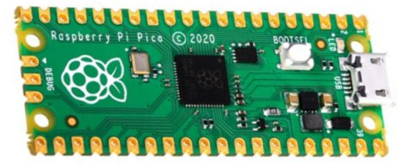
Demo install
Install by hand:
Connect Pi Pico USB while button pressed
RPI-RP (D:) drive shows up in explorer
Copy MicroPython image file to RPI-RP (D:)
Install using Thonny:
Again, Connect Pi Pico USB while button pressed
InThonny: Tools → Options → Interpreter
→ Select MicroPython (Rasberry Pi Pico)
→ Install or update MicroPython, variant H or HW
In thonny REPL:
print ( “Hello” )

Slide 14
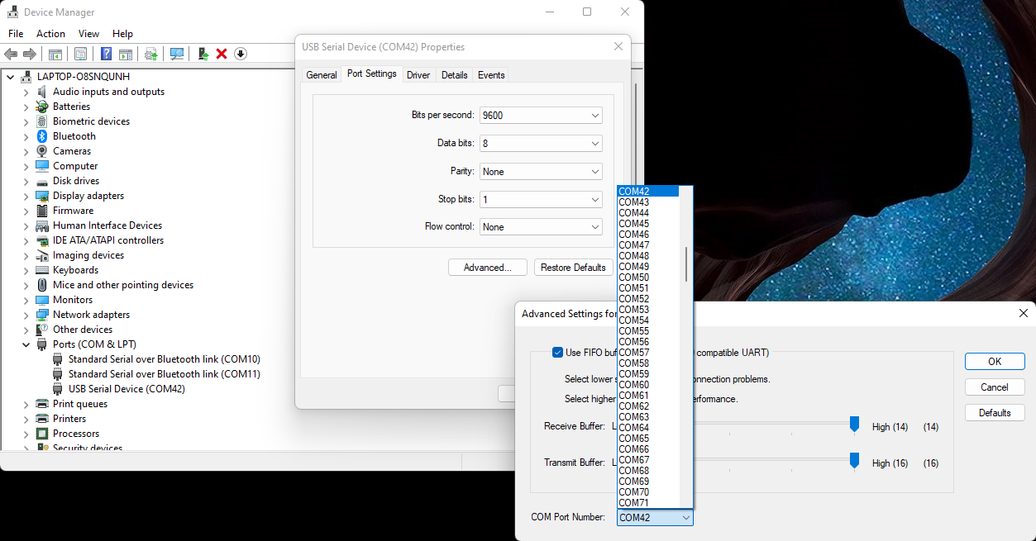
(rename serial port)

Slide 15
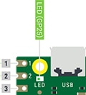
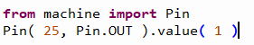
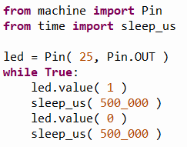
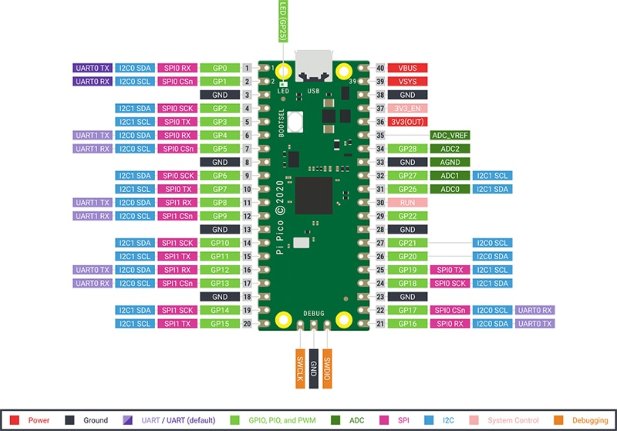
Demo on-board blinky
In Thonny REPL:
In Tonny editor:

Slide 16
Startup
boot.py runs first (at reset or power-up)
REPL STOP is a reset, and re-runs boot.py,
keyboard interrupt doesn’t re-run boot.py
Don’t mess with boot.py unless you really know what you are doing
main.py file runs after boot.py
REPL STOP doesn’t re-run main.py
keyboard interrupt doesn’t re-run main.py either
Put your startup line (import myapp.py) in main.py

Slide 17
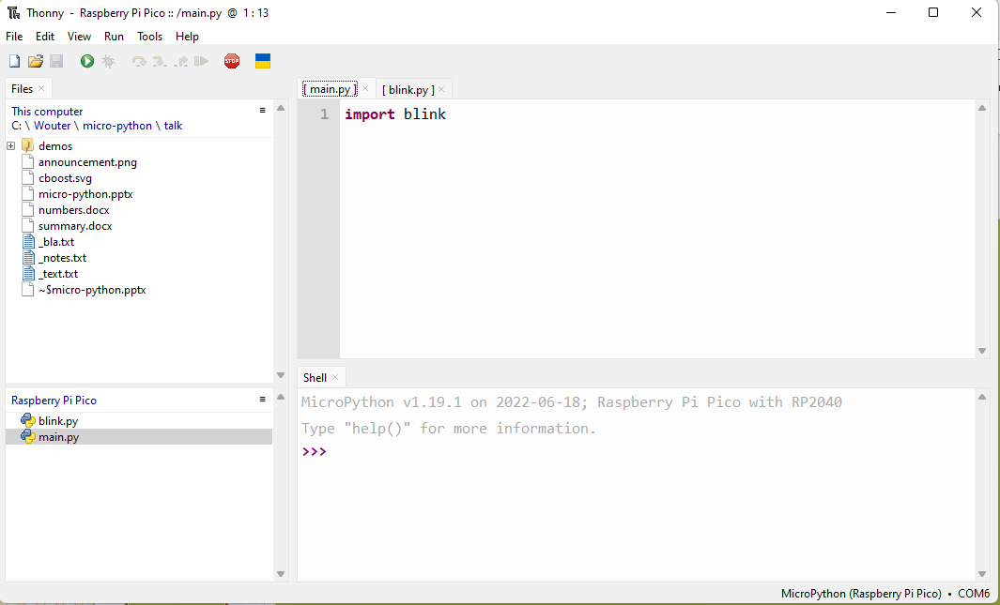
Demo startup
Save blink.py on the target
Create main.py on the target
Connect to power bank

Slide 18
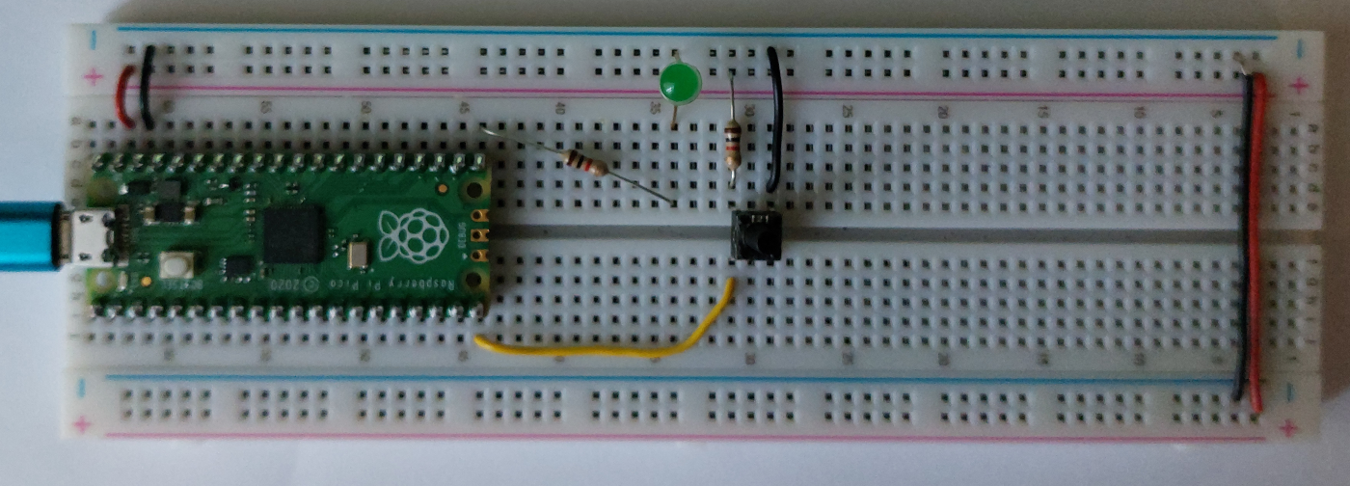
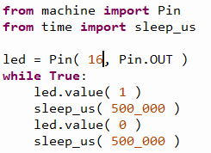
Demo external LED

Slide 19
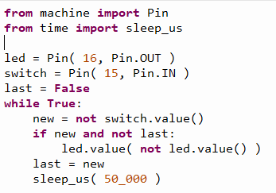
Demo input button

Slide 20
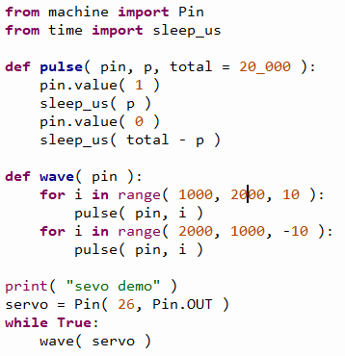
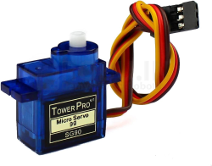
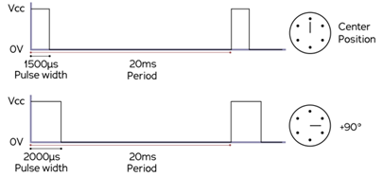
Demo servo motor

Slide 21
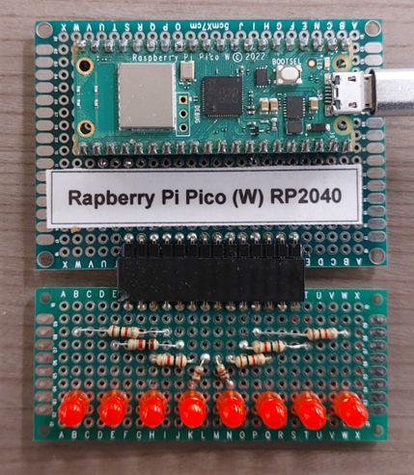
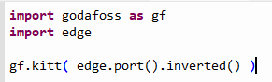
More LEDs!

Slide 22
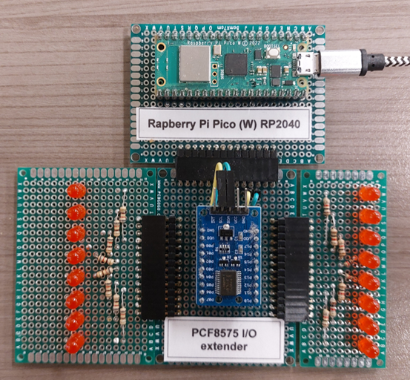
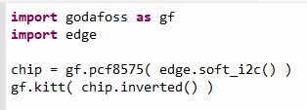
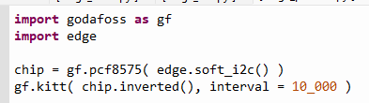
You still want more LEDs?

Slide 23
3 ways
3 ways to work on and use a library
As (.py) sources
As (.mpy) pre-compiled code
As frozen (.mpy) code in the image
Compare using
Pi Pico RP2040 (without W)
MicroPython v1.19.1
Thonny for upload
My feeble laptop for building
My godafosss library code, with on-demand loading (85 files, 471 Kb, heavily commented)

Slide 24
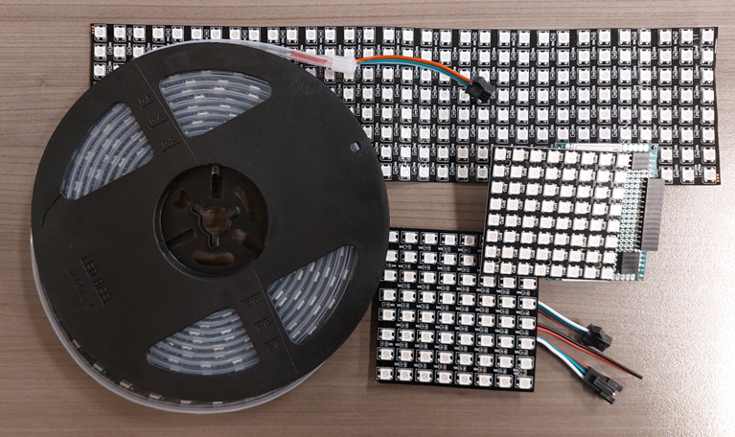
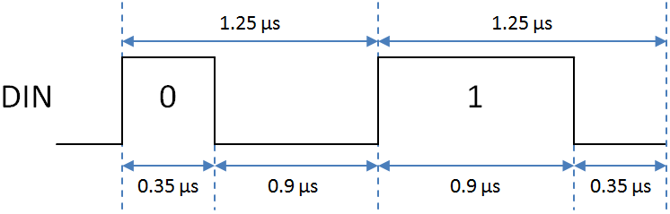
I still want more LEDs
Demo: Neopixels strip

Slide 25
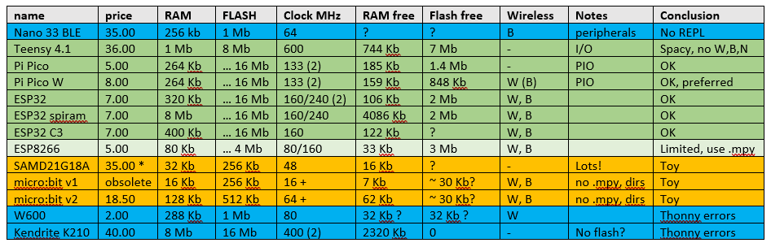
Some target chips/boards

Slide 26

RAM
RAM is scarce, the Python is hungry
Split into smaller files to avoid peak RAM use
Use demand-loading (code)
Use pre-compiled files (mpy-cross)
Incorporate (pre-compiled) library files into the MicroPython image (demo)
Use a big fat fast target chip for development

Slide 27
On-demand loading
from submodule import classname
def classname( *args, **kwargs ):
from submodule import classname
return classname(*args, **kwargs )
One trampoline takes ~ 50 bytes
The real code is a bit more complicated

Slide 28
Limitations
Uses a lot of RAM, especially for an LCD graphic buffer
Speed is low (compared to running native code) and can be unpredictable (garbage collection)
Some timing-based HW interface protocols (neopixels, dallas one-wire, DHT11) are not feasible in native Python
Some doubts about running longer time (memory fragmentation), needs occasional 2nd start ☹
Needs more expensive hardware (than a native-code application)
Might use more power (than a native-code application)
Organization is MUCH smaller than python.org (hobbyistic)
Some standard libraries are not available and/or impractical (CPU & memory load)
Not all ports are equal (especially in WiFi details and built-in HW libraries)
No multi-threading (except when multiple CPUs are available)
Type hints not implemented yet

Slide 29
Timing / performance
How much time do you have to do something simple?
1 - 10’s of CPU clock cycles: hardware peripherals, assembler, RP2040 PIO’s
10 - 100’s of CPU clock cycles: C, C++, Rust (or PicroPython built-in)
100’s - 1000’s of CPU clock cycles: MicroPython native
us
ms

Slide 30
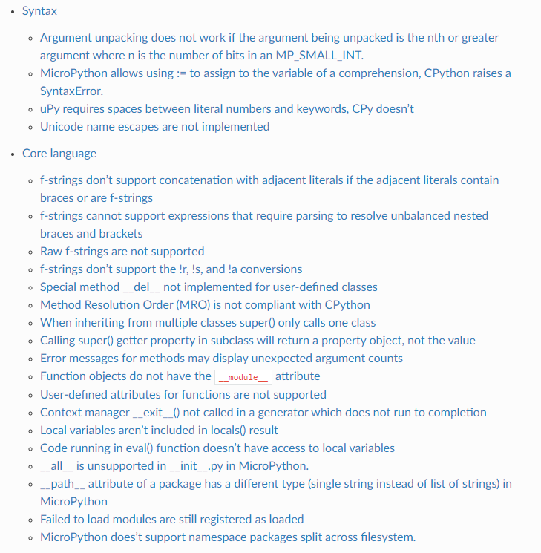
Deviations from CPython
Source: https://docs.micropython.org/en/latest/genrst

Slide 31
Application areas
When faster development outweighs the extra hardware cost:
Tinkering (hobby, education, exploratory work, lab setting)
Prototyping, proof-of-concepts, demos
Testing
Small series
When a somewhat knowledgeable end-user must do some tweaking

Slide 32
Caveats
Where is my code? Be sure to save your work on your PC (too)!
USB can supply only a limited amount of current
Upload, Download
Some chips claim MicroPython support but don’t fully deliver (W600, K210).
An uploaded file is sometimes not recognized as newer? (solution: add a space and upload again)
Thonny sometimes crashes (especially on communication problems – don’t pull the cable!)
Different MicroPython versions and ports can be subtly different (like no neopixel support on Teensy)
Want to protect your IP? Probably forget it.

Slide 33
Not covered
Wireless REPL (WiFi)
Embedding native compiled code in the interpreter
Thonny alternatives
CircuitPython: proprietary variation by AdaFruit, very similar but some (irritating) differences
Extending MicroPython by embedding native code in the interpreter (C, C++)
Using MicroPython with RP2040 PIOs
Native code generators (@micropython.native, @micropython.viper)

Slide 34
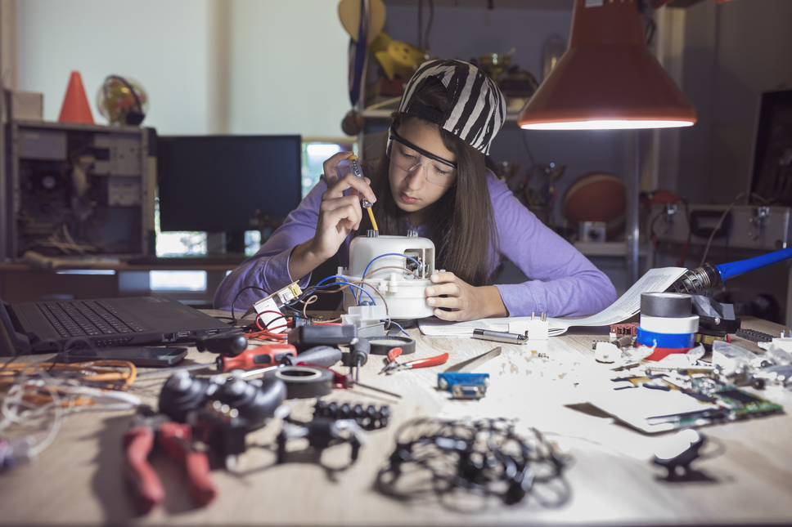

Takeaway?
Get
Arduino peripherals set (cheap!)
Pi RP2040 (or ESP32, Teensy 4.1)
Start tinkering!

